Slide 1
Intro to: Inter-Processor Communications (IPC)

Slide 2
Agenda
Basic Concepts
IPC library
msgCom
Pktio
Demos and examples
Notes:
NEW

Slide 3
IPC – Definition
IPC = Inter-Processor Communication
While this definition is rather generic, it really means:
“Transporting data and/or signals between threads of execution”
These threads could be located anywhere:
Thread 1
Data
Thread 2
CorePac 0
CorePac 0
Device 0
CorePac 0
CorePac 1
Device 1

Slide 4
IPC – RTOS/Framework Solutions
SAME CorePac: TI’s RTOS (SYS/BIOS) supports several services for inter-thread communication (e.g. semaphores, queues, mailboxes, etc.).
DIFFERENT CorePac: The IPC framework supports communications between CorePacs.
DIFFERENT DEVICE: IPC transports can also be implemented between devices.
KEY: Same IPC APIs can be used for local or remote communications.
Thread 1
Data
Thread 2
Solutions
CorePac 0
CorePac 0
Device 0
CorePac 0
CorePac 1
Device 1
SYS/BIOS (or IPC)
IPC + transport
IPC + transport

Slide 5
IPC Transports
Shared memory – MSMC memory or DDR
IPC registers set provides hardware interrupt to cores
Multicore navigator
Various peripherals for communication between devices

Slide 6
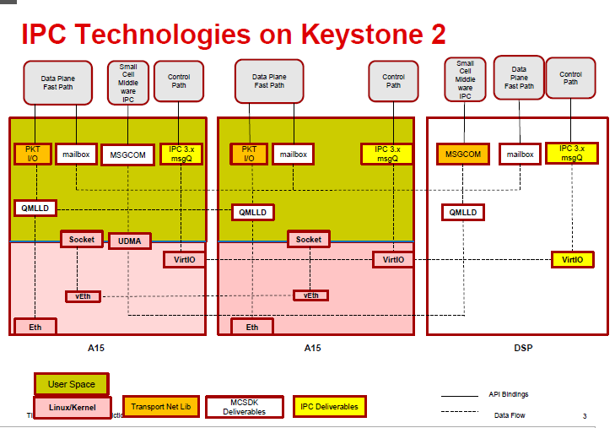

Slide 7
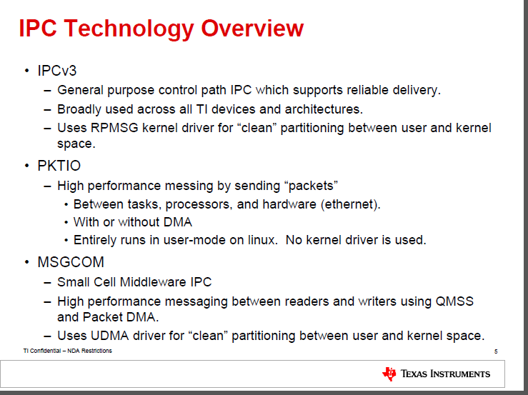
IPC Linux Libraries

Slide 8
IPC DSP Libraries
IPC V3 – uses shared memory transport layer
Direct usage of the QMSS LLD to send messages between cores – complementary of PKTIO library on Linux
msgCom library – enhanced functionality uses
multicore navigator transport layer
All these libraries are part of TI MCSDK release

Slide 9
Agenda
Basic Concepts
IPC library
msgCom
Pktio
Demos and examples
Notes:
NEW

Slide 10
IPC Library – Transports
Current IPC implementation uses several transports:
CorePac → CorePac (Shared Memory Model)
Device → Device (Serial Rapid I/O)
Chosen at configuration; Same code regardless of thread location.
Device 1
Device 2
CorePac 1
CorePac 2
CorePac 1
Thread 1
Thread 2
Thread 1
Thread 2
Thread 1
Thread 2
IPC
IPC
IPC
MEM
SRIO
SRIO

Slide 11
IPC Services
The IPC package is a set of APIs
MessageQ uses the modules below …
But each module can also be used independently.
Application

Slide 12
MessageQ – Highest Layer API
SINGLE reader, multiple WRITERS model (READER owns queue/mailbox)
Supports structured sending/receiving of variable-length messages, which can include (pointers to) data
Uses all of the IPC services layers along with IPC Configuration & Initialization
APIs do not change if the message is between two threads:
On the same core
On two different cores
On two different devices
APIs do NOT change based on transport – only the CFG (init) code
Shared memory
Multicore Navigator
SRIO

Slide 13
MessageQ and Messages
How does the writer connect with the reader queue?
MultiProc and name server keep track of queue names and core IDs.
What do we mean when we refer to structured messages with variable size?
Each message has a standard header and data. The header specifies the size of payload.
How and where are messages allocated?
List utility provides a double-link list mechanism. The actual allocation of the memory is done by HeapMP, SharedRegion, and ListMP.
If there are multiple writers, how does the system prevent race conditions (e.g., two writers attempting to allocate the same memory)?
GateMP provides hardware semaphore API to prevent race conditions.
What facilitates the moving of a message to the receiver queue?
This is done by Notify API using the transport layer.
Does the application need to configure all these modules?
No. Most of the configuration is done by the system. More details later.

Slide 14
Using MessageQ (1/3)
CorePac 2 - READER
MessageQ_create(“myQ”, *synchronizer);
MessageQ_get(“myQ”, &msg, timeout);
“myQ”
MessageQ transactions begin with READER creating a MessageQ.
READER’s attempt to get a message results in a block (unless timeout was specified), since no messages are in the queue yet.
What happens next?

Slide 15
Using MessageQ (2/3)
CorePac 1 - WRITER
CorePac 2 - READER
MessageQ_open (“myQ”, …);
msg = MessageQ_alloc (heap, size,…);
MessageQ_put(“myQ”, msg, …);
MessageQ_create(“myQ”, …);
MessageQ_get(“myQ”, &msg…);
“myQ”
Heap
WRITER begins by opening MessageQ created by READER.
WRITER gets a message block from a heap and fills it, as desired.
WRITER puts the message into the MessageQ.
How does the READER get unblocked?

Slide 16
Using MessageQ (3/3)
CorePac 1 - WRITER
CorePac 2 - READER
MessageQ_open (“myQ”, …);
msg = MessageQ_alloc (heap, size,…);
MessageQ_put(“myQ”, msg, …);
MessageQ_close(“myQ”, …);
MessageQ_create(“myQ”, …);
MessageQ_get(“myQ”, &msg…);
*** PROCESS MSG ***
MessageQ_free(“myQ”, …);
MessageQ_delete(“myQ”, …);
“myQ”
Heap
Once WRITER puts msg in MessageQ, READER is unblocked.
READER can now read/process the received message.
READER frees message back to Heap.
READER can optionally delete the created MessageQ, if desired.

Slide 17
MessageQ – Configuration
All API calls use the MessageQ module in IPC.
User must also configure MultiProc and SharedRegion modules.
All other configuration/setup is performed automatically by MessageQ.
User APIs
MessageQ
Notify
ListMP
HeapMemMP +
Uses
MultiProc
Uses
Shared Region
Uses
Cfg
GateMP
NameServer

Slide 18
MessageQ – Miscellaneous Notes
O/S independent:
If one CorePac is running LINUX and using SysLink, the API calls do not change.
SysLink is runtime software that provides connectivity between processors (running Linux, SYSBIOS, etc.)
Messages can be allocated statically or dynamically.
Timeouts are allowed when a task receives a message.
User can specify three priority levels:
Normal
High
Urgent

Slide 19
More Information About MessageQ
For the DSP, All structures and function descriptions are exposed to the user and can be found within the release:
\ipc_U_ZZ_YY_XX\docs\doxygen\html\_message_q_8h.html
IPC User Guide (for DSP and ARM) is in
\MCSDK_3_00_XX\ipc_3_XX_XX_XX\docs\IPC_Users_Guide.pdf
Notes:
NEW

Slide 20
Using Notify – Concepts
In addition to moving MessageQ messages, Notify:
Can be used independently of MessageQ
Is a simpler form of IPC communication
Device 1
CorePac 1
CorePac 2
Thread 1
Thread 2
Thread 1
Thread 2
IPC
IPC
MEM

Slide 21
Notify Model
Comprised of SENDER and RECEIVER.
The SENDER API requires the following information:
Destination (SENDER ID is implicit)
16-bit Line ID
32-bit Event ID
32-bit payload (For example, a pointer to message handle)
The SENDER API generates an interrupt (an event) in the destination.
Based on Line ID and Event ID, the RECEIVER schedules a pre-defined call-back function.

Slide 22
Notify Model

Slide 23
Notify Implementation
How are interrupts generated for shared memory transport?
The IPC hardware registers are a set of 32-bit registers that generate interrupts. There is one register for each core.
How are the notify parameters stored?
List utility provides a double-link list mechanism. The actual allocation of the memory is done by HeapMP, SharedRegion, and ListMP.
How does the notify know to send the message to the correct destination?
MultiProc and name server keep track of the core ID.
Does the application need to configure all these modules?
No. Most of the configuration is done by the system.

Slide 24
Example Callback Function
/*
* ======== cbFxn ========
* This fxn was registered with Notify. It is called when any event is sent to this CPU.
*/
Uint32 recvProcId ;
Uint32 seq ;
void cbFxn(UInt16 procId, UInt16 lineId, UInt32 eventId, UArg arg, UInt32 payload)
{
/* The payload is a sequence number. */
recvProcId = procId;
seq = payload;
Semaphore_post(semHandle);
}

Slide 25
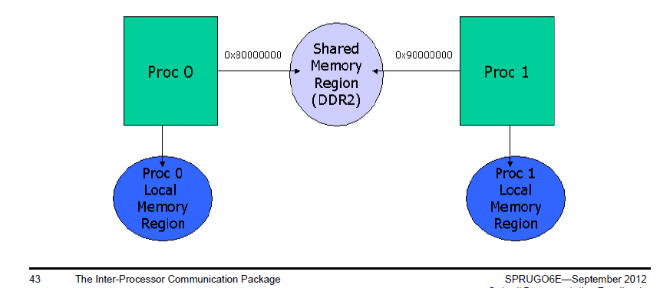
Data Passing Using Shared Memory (1/2)
When there is a need to allocate memory that is accessible by multiple cores, shared memory is used.
However, the MPAX register for each core might assign a different logical address to the same physical shared memory address.
The Shared Region module provides a translation look-up table that resolves the logical/physical address issue

Slide 26
Data Passing Using Shared Memory (2/2)
Messages are created and freed, but not necessarily in consecutive order:
HeapMP provides a dynamic heap utility that supports create and free based on double link list architecture.
ListMP provides a double link list utility that makes it easy to create and free messages for static memory. It is used by the HeapMP for dynamic cases.
To protect the above utilities from race conditions (e.g., multiple cores try to create messages at the same time):
GateMP provides hardware semaphore protection.
GateMP can also be used by non-IPC applications to assign hardware semaphores.

Slide 27
Data Passing – Static
Data Passing uses a double linked list that can be shared between CorePacs; Linked list is defined STATICALLY.
ListMP handles address translation and cache coherency.
GateMP protects read/write accesses.
ListMP is typically used by MessageQ not by itself.
User APIs
Notify
ListMP
Uses
MultiProc
Uses
Shared Region
Cfg
GateMP
NameServer

Slide 28
Data Passing – Dynamic
Data Passing uses a double linked list that can be shared between CPUs. Linked list is defined DYNAMICALLY (via heap).
Same as previous, except linked lists are allocated from Heap
Typically not used alone – but as a building block for MessageQ
User APIs
Notify
ListMP
HeapMemMP +
Uses
MultiProc
Uses
Shared Region
Uses
Cfg
GateMP
NameServer

Slide 29
IPC Device to Device Using SRIO
Notes:
NEW

Slide 30
IPC Transports – SRIO (1/3)
The SRIO (Type 11) transport enables MessageQ to send data between tasks, cores and devices via the SRIO IP block.
Refer to the MCSDK examples for setup code required to use MessageQ over this transport.
Chip V CorePac W
Chip X CorePac Y
msg = MessageQ_alloc
“get Msg from queue”
MessageQ_put(queueId, msg)
MessageQ_get(queueHndl,rxMsg)
TransportSrio_put
MessageQ_put(queueId, rxMsg)
Srio_sockSend(pkt, dstAddr)
TransportSrio_isr
SRIO x4
SRIO x4

Slide 31
IPC Transports – SRIO (2/3)
From a messageQ standpoint, the SRIO transport works the same as the QMSS transport. At the transport level, it is also somewhat the same.
The SRIO transport copies the messageQ message into the SRIO data buffer.
It will then pop a SRIO descriptor and put a pointer to the SRIO data buffer into the descriptor.
Chip V CorePac W
Chip X CorePac Y
msg = MessageQ_alloc
“get Msg from queue”
MessageQ_put(queueId, msg)
MessageQ_get(queueHndl,rxMsg)
TransportSrio_put
MessageQ_put(queueId, rxMsg)
Srio_sockSend(pkt, dstAddr)
TransportSrio_isr
SRIO x4
SRIO x4

Slide 32
IPC Transports – SRIO (3/3)
The transport then passes the descriptor to the SRIO LLD via the Srio_sockSend API.
SRIO then sends and receives the buffer via the SRIO PKTDMA.
The message is then queued on the Receiver side.
Chip V CorePac W
Chip X CorePac Y
msg = MessageQ_alloc
“get Msg from queue”
MessageQ_put(queueId, msg)
MessageQ_get(queueHndl,rxMsg)
TransportSrio_put
MessageQ_put(queueId, rxMsg)
Srio_sockSend(pkt, dstAddr)
TransportSrio_isr
SRIO x4
SRIO x4
Notes:
Dotted line to show what the application is doing and what is done automatically

Slide 33
IPC Transport Details
Throughput (Mb/second)
Message Size
(Bytes)
Shared
Memory
SRIO
48
23.8
4.1
256
125.8
21.2
1024
503.2
-
Benchmark Details
IPC Benchmark Examples from MCSDK
CPU Clock – 1 GHz
Header Size– 32 bytes
SRIO – Loopback Mode
Messages allocated up front

Slide 34
Agenda
Basic Concepts
IPC library
msgCom
Pktio
Demos and examples
Notes:
NEW

Slide 35
MsgCom Library
Purpose: To exchange messages between a reader and writer.
Read/write applications can reside:
On the same DSP core
On different DSP cores
On both the ARM and DSP core
Channel and interrupt-based communication:
Channel is defined by the reader (message destination) side
Supports multiple writers (message sources)

Slide 36
Channel Types
Simple Queue Channels: Messages are placed directly into a destination hardware queue that is associated with a reader.
Virtual Channels: Multiple virtual channels are associated with the same hardware queue.
Queue DMA Channels: Messages are copied using infrastructure PKTDMA between the writer and the reader.
Proxy Queue Channels: Indirect channels work over BSD sockets; Enable communications between Writer and Reader that are not connected to the same instance of Multicore Navigator.

Slide 37
Interrupt Types
No interrupt: Reader polls until a message arrives.
Direct Interrupt:
Low-delay system
Special queues must be used.
Accumulated Interrupts:
Special queues are used.
Reader receives an interrupt when the number of messages crosses a defined threshold.

Slide 38
Blocking and Non-Blocking
Blocking: Reader can be blocked until message is available.
Blocked by software semaphore which BIOS assigns on DSP side
Also utilizes software semaphore on ARM side, taken care of by Job Scheduler (JOSH)
Implementation of software semaphore occurs in OSAL layer on both ARM and DSP.
Non-blocking:
Reader polls for a message.
If there is no message, it continues execution.

Slide 39
Case 1: Generic Channel Communication Zero Copy-based Constructions: Core-to-Core
NOTE: Logical function only
hCh=Find(“MyCh1”);
hCh = Create(“MyCh1”);
Reader
Writer
MyCh1
Tibuf *msg = PktLibAlloc(hHeap);
Put(hCh,msg);
Tibuf *msg =Get(hCh);
PktLibFree(msg);
Delete(hCh);
Reader creates a channel ahead of time with a given name (e.g., MyCh1).
When the Writer has information to write, it looks for the channel (find).
Writer asks for a buffer and writes the message into the buffer.
Writer does a “put” to the buffer. Multicore Navigator does it – magic!
When Reader calls “get,” it receives the message.
Reader must “free” the message after it is done reading.
Notes:
Notes:
All naming is illustrative.
Open Items:
Recycling policies on Tx Completion queues
API Naming convention

Slide 40
Case 2: Low-Latency Channel Communication Single and Virtual Channel Zero Copy-based Construction: Core-to-Core
NOTE: Logical function only
Reader
Writer
hCh = Create(“MyCh2”);
MyCh2
Posts internal Sem and/or callback posts MySem;
hCh=Find(“MyCh2”);
chRx
(driver)
Get(hCh); or Pend(MySem);
Tibuf *msg = PktLibAlloc(hHeap);
Put(hCh,msg);
PktLibFree(msg);
hCh=Find(“MyCh3”);
MyCh3
hCh = Create(“MyCh3”);
Tibuf *msg = PktLibAlloc(hHeap);
Get(hCh); or Pend(MySem);
Put(hCh,msg);
PktLibFree(msg);
Reader creates a channel based on a pending queue. The channel is created ahead of time with a given name (e.g., MyCh2).
Reader waits for the message by pending on a (software) semaphore.
When Writer has information to write, it looks for the channel (find).
Writer asks for buffer and writes the message into the buffer.
Writer does a “put” to the buffer. Multicore Navigator generates an interrupt . The ISR posts the semaphore to the correct channel.
Reader starts processing the message.
Virtual channel structure enables usage of a single interrupt to post semaphore to one of many channels.
Notes:
Notes:
All naming is illustrative.
Open Items:
Recycling policies on Tx Completion queues
API Naming convention

Slide 41
Case 3: Reduce Context Switching Zero Copy-based Constructions: Core-to-Core
NOTE: Logical function only
Reader
Writer
hCh = Create(“MyCh4”);
hCh=Find(“MyCh4”);
MyCh4
Tibuf *msg =Get(hCh);
Tibuf *msg = PktLibAlloc(hHeap);
chRx
(driver)
Put(hCh,msg);
Accumulator
PktLibFree(msg);
Delete(hCh);
Reader creates a channel based on an accumulator queue. The channel is created ahead of time with a given name (e.g., MyCh4).
When Writer has information to write, it looks for the channel (find).
Writer asks for buffer and writes the message into the buffer.
Writer does a “put” to the buffer. Multicore Navigator adds the message to an accumulator queue.
When the number of messages reaches a threshold, or after a pre-defined time out, the accumulator sends an interrupt to the core.
Reader starts processing the message and makes it “free” after it is done.
Notes:
Notes:
All naming is illustrative.
Open Items:
Recycling policies on Tx Completion queues
API Naming convention

Slide 42
Case 4: Generic Channel Communication ARM-to-DSP Communications via Linux Kernel VirtQueue
NOTE: Logical function only
Reader
Writer
hCh = Create(“MyCh5”);
hCh=Find(“MyCh5”);
MyCh5
Tibuf *msg =Get(hCh);
msg = PktLibAlloc(hHeap);
Put(hCh,msg);
Tx
PKTDMA
Rx
PKTDMA
PktLibFree(msg);
Delete(hCh);
Reader creates a channel ahead of time with a given name (e.g., MyCh5).
When Writer has information to write, it looks for the channel (find). The kernel is aware of the user space handle.
Writer asks for a buffer. The kernel dedicates a descriptor to the channel and provides Writer with a pointer to a buffer that is associated with the descriptor. Writer writes the message into the buffer.
Writer does a “put” to the buffer. The kernel pushes the descriptor into the right queue. Multicore Navigator does a loopback (copies the descriptor data) and frees the Kernel queue. Multicore Navigator then loads the data into another descriptor and sends it to the appropriate core.
When Reader calls “get,” it receives the message.
Reader must “free” the message after it is done reading.
Notes:
Notes:
All naming is illustrative.
Open Items:
Recycling policies on Tx Completion queues
API Naming convention

Slide 43
Case 5: Low-Latency Channel Communication ARM-to-DSP Communications via Linux Kernel VirtQueue
NOTE: Logical function only
hCh = Create(“MyCh6”);
Reader
Writer
MyCh6
chIRx
(driver)
Get(hCh); or Pend(MySem);
hCh=Find(“MyCh6”);
msg = PktLibAlloc(hHeap);
Put(hCh,msg);
Tx
PKTDMA
Rx
PKTDMA
PktLibFree(msg);
Delete(hCh);
PktLibFree(msg);
Reader creates a channel based on a pending queue. The channel is created ahead of time with a given name (e.g., MyCh6).
Reader waits for the message by pending on a (software) semaphore.
When Writer has information to write, it looks for the channel (find). The kernel space is aware of the handle.
Writer asks for a buffer. Kernel dedicates a descriptor to the channel and provides Writer with a pointer to a buffer associated with the descriptor. Writer writes message to the buffer.
Writer does a “put” to the buffer. The kernel pushes the descriptor into the right queue. Multicore Navigator does a loopback (copies the descriptor data) and frees the kernel queue. Multicore Navigator then loads the data into another descriptor, moves it to the right queue, and generates an interrupt. The ISR posts the semaphore to the correct channel.
Reader starts processing the message.
Virtual channel structure enables usage of a single interrupt to post semaphore to one of many channels.
Notes:
Notes:
All naming is illustrative.
Open Items:
Recycling policies on Tx Completion queues
API Naming convention

Slide 44
Case 6: Reduce Context Switching ARM-to-DSP Communications via Linux Kernel VirtQueue
NOTE: Logical function only
hCh=Find(“MyCh7”);
hCh = Create(“MyCh7”);
Reader
Writer
MyCh7
Msg = Get(hCh);
chRx
(driver)
msg = PktLibAlloc(hHeap);
Put(hCh,msg);
Tx
PKTDMA
Rx
PKTDMA
Accumulator
PktLibFree(msg);
Delete(hCh);
Reader creates a channel based on one of the accumulator queues. The channel is created ahead of time with a given name (e.g., MyCh7).
When Writer has information to write, it looks for the channel (find). The kernel space is aware of the handle.
Writer asks for a buffer. The kernel dedicates a descriptor to the channel and gives Writer a pointer to a buffer that is associated with the descriptor. Writer writes the message into the buffer.
Writer does a “put” to the buffer. The kernel pushes the descriptor into the right queue. Multicore Navigator does a loopback (copies the descriptor data) and frees the kernel queue. Multicore Navigator then loads the data into another descriptor and adds the message to an accumulator queue.
When the number of messages reaches a threshold, or after a pre-defined time out, the accumulator sends an interrupt to the core.
Reader starts processing the message and frees it after it is complete.
Notes:
Notes:
All naming is illustrative.
Open Items:
Recycling policies on Tx Completion queues
API Naming convention

Slide 45
More Information on msgCom
msgCom is part of the SysLib module in the release. User Guide (for DSP and ARM) is in
\MCSDK_3_00_XX\syslib_3_XX_XX_XX\docs\docs\Syslib_User_Guide.pdf
Notes:
NEW

Slide 46
Agenda
Basic Concepts
IPC library
msgCom
Pktio
Demos and examples
Notes:
NEW

Slide 47
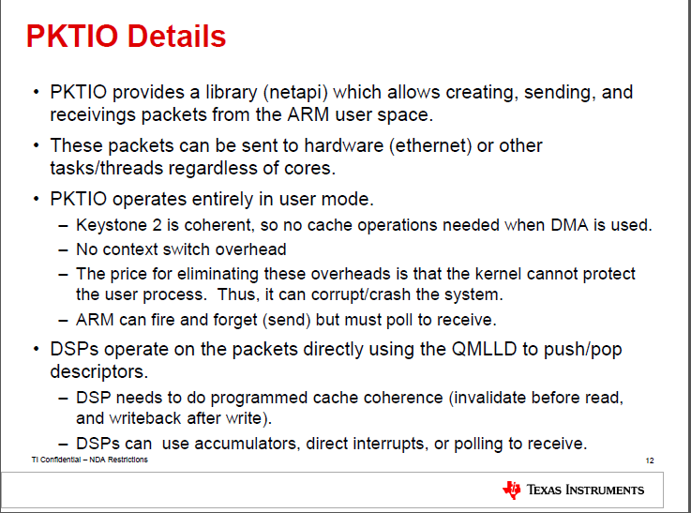
PKTIO Library

Slide 48
More Information on Pktio
PKTIO is part of Linux library TransportNetLib library that supports multiple connectivity methods, within and outside of the device
User guide can be found at http://processors.wiki.ti.com/index.php/TransportNetLib_UsersGuide
DSP support for the PKTIO is part of the QMSS LLD, information of the QMSS LLD can be found at MCSDK_3_00_xx\pdk_keystone2_x_xx_xx_xx\packages\ti\drv\qmss\docs\doxygen\html
Notes:
NEW

Slide 49
Agenda
Basic Concepts
IPC library
msgCom
Pktio
Demos and examples
Notes:
NEW

Slide 50
Examples and Demos
There are multiple IPC library example projects for KeyStone I in the MCSDK 2 release at mcsdk_2_X_X_X\pdk_C6678_1_1_2_5\packages\ti\transport\ipc\examples
msgCom project (on ARM and DSP) is part of KeyStone II Lab Book

Slide 51
ti

